Slide 1
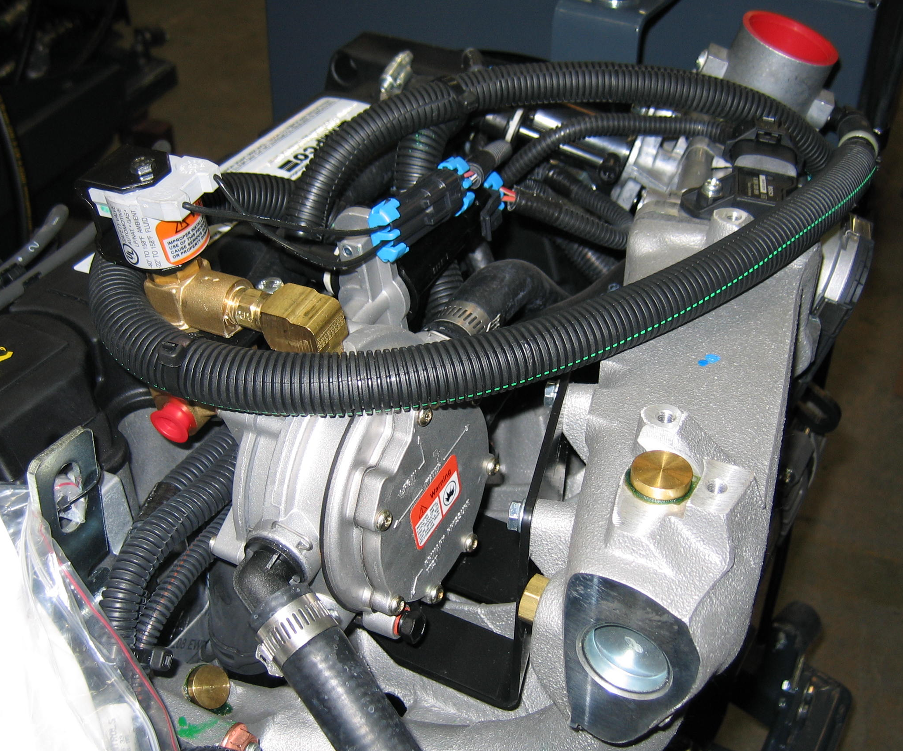
LPG Fuel Lock w/Filter 32500878
Cobra Regulator, Tier I 1.6L, CS4-30772-004

Slide 2
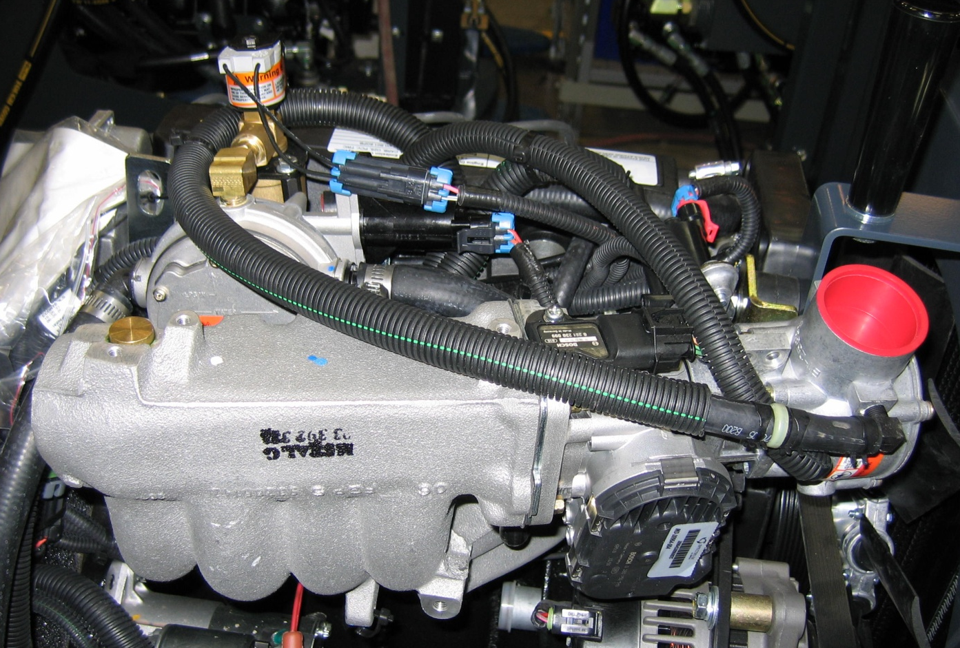
LPG Fuel Lock w/Filter 32500878
LPG Fuel Mixer, Tier I 1.6L, FT60M-30741-52-003
Throttle Body, 3250697

